Slide 1
Lander Nordal
2017 MECOP Presentation

Slide 2

Introduction
Personal Information
Name: Lander Nordal
Major: Mechanical Engineering
School: Oregon Tech
First Internship
Department: Corporate Manufacturing
Mentor: Scott Handley
Supervisor: Eric Schmidt

Slide 3
Hours, Wages, Etc.
Business casual attire.
Flexible hours
7:00-3:30
$20hr @ 40 Hours Weekly
No benefits
No overtime
Temp Agency handles wages and interns cannot qualify for insurance even through them.

Slide 4
Corporate Structure
Colin Wilson
CEO
Rajiv Prasad
Sr. VP
Eric Schmidt
Director of Corporate MFG engineering
Corporate MFG
Team
Lander Nordal
MECOP Intern

Slide 5
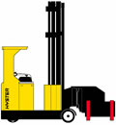
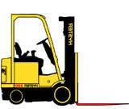
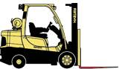
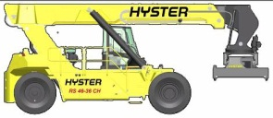
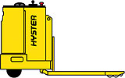
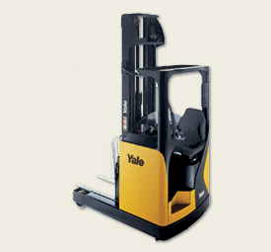
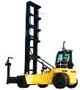
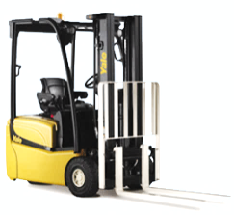
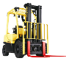
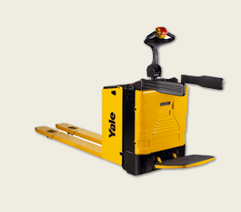
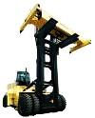
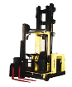
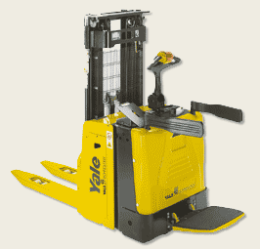
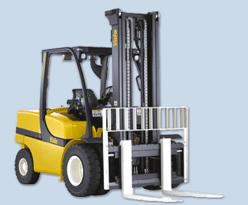
Product Lines
Class I
Class II
Class III
Class IV
Class V
Electric Counterbalanced Rider Trucks
Electric Narrow Aisle Trucks
Electric Hand Trucks
Internal Combustion Engine (Cushion)
Internal Combustion Engine (Pneumatic)
1.0T to 5.5T
Capacity
1.5T to 6.0T
Capacity
1.5T to 8.0T
Capacity
1.0T to 7.0T
Capacity
1.0T to 52.0T
Capacity
Electric CB
Warehouse Equipment
ICE CB
Big Trucks
Reach Trucks
Order Pickers
3 wheel Electric
Internal Combustion Engine
Reach Stackers
Empty Container Handlers
Pallet Trucks
4 wheel Electric
Very Narrow Aisle Trucks
Stackers
Laden Container Handlers
Forklifts

Slide 6
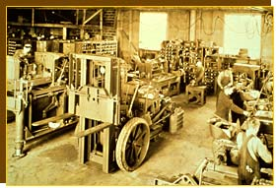
History
In 1920 Yale & Towne Manufacturing produced its first Lift Truck.
In 1934 Willamette Hyster Company introduces its first Lift Truck
In 1967 The CBDC site was opened, used as a test location for Hyster.
In 1985 NACCO (North American Coal Company) purchases a controlling interest in Yale.
In 1989 NACCO Acquires the Hyster Brand. NMHG (NACCO Materials Handling Group) is created to integrate and manage the two companies as one.
In 1998 Engineering Design and Support was moved to the Fairview Test location. Renamed CBDC (Counterbalanced Development Center).
In 2012 NMHG separated from NACCO industries to become a separate traded company
In 2016 changed name to Hyster-Yale Group

Slide 7
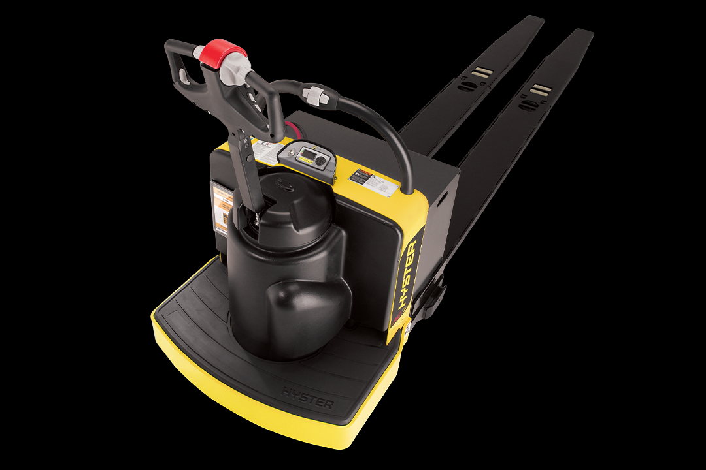
Projects
Tool Design
Update Existing Tools
Create New Tools – End Rider
aPriori
Update to latest version
Cost parts
Catalog Tooling
Update library
2020
2-3T Capital Database
Weld Distortion
Research predictive weld distortion software

Slide 8
Tool Design – End Rider Overview
Tasks:
Design 2 tack weld fixtures
Design 3 pickoff weld fixtures
Fixture Requirements:
Locate all piece parts
Tolerance stack-ups
Allow accessibility to weld joints
Accommodate all variations of assemblies

Slide 9
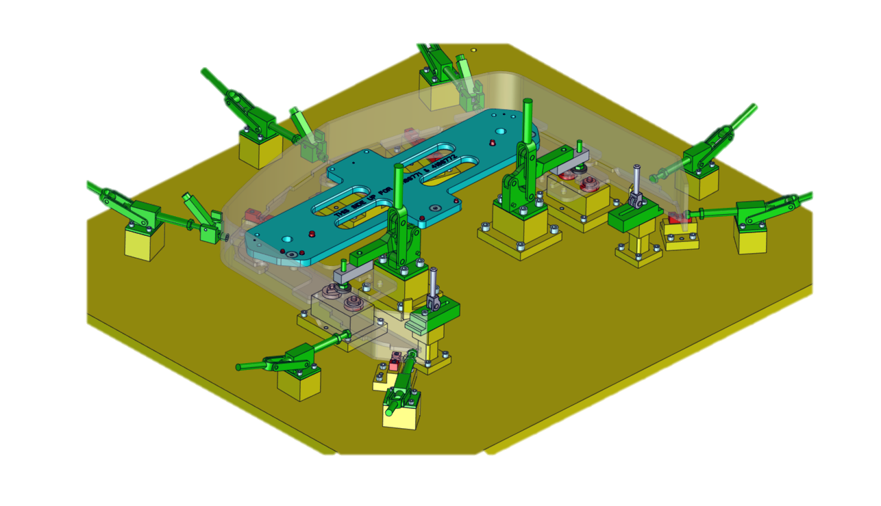
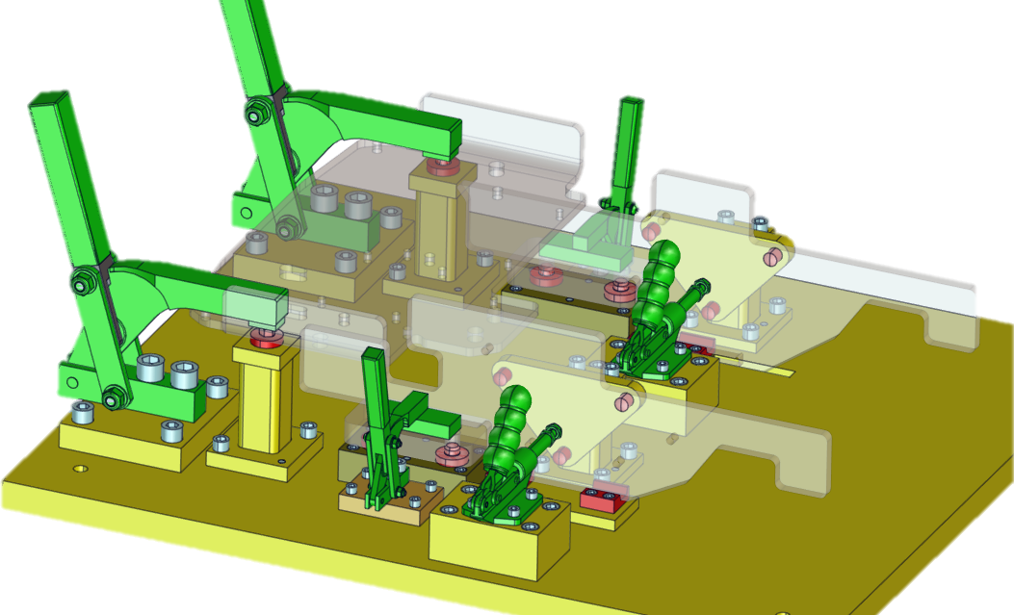
Tool Design
2 Tack Weld Fixtures

Slide 10
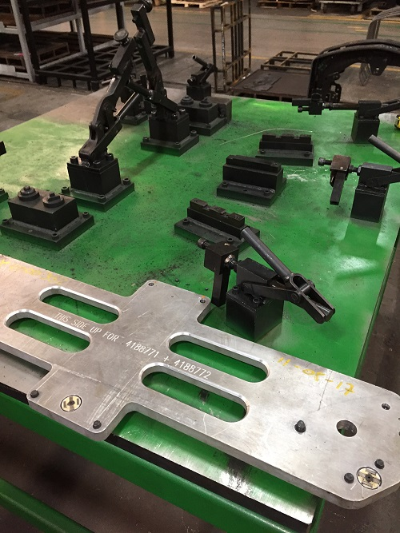
Feedback From Plant
Several bumpers built
Liked the tool
Magnets not working

Slide 11
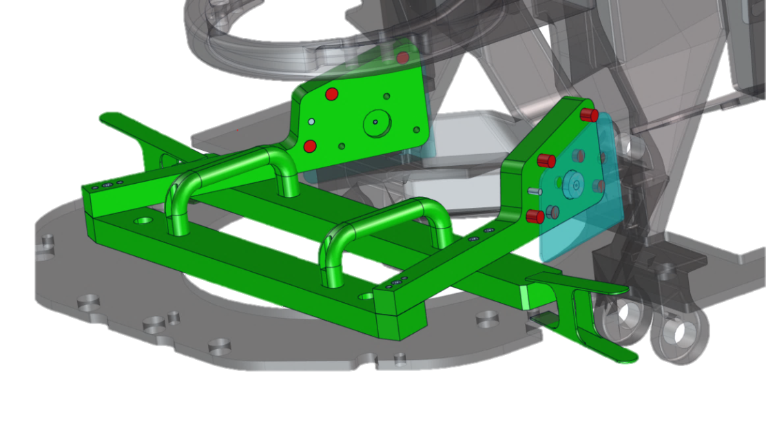
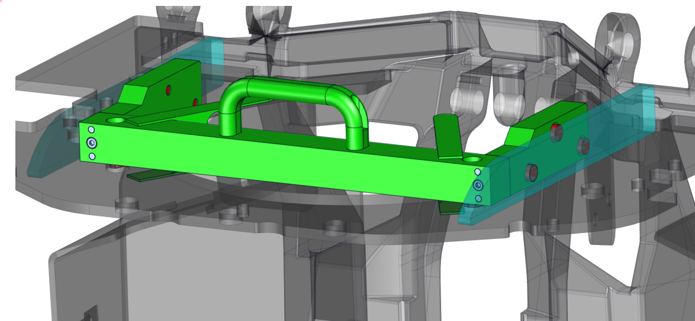
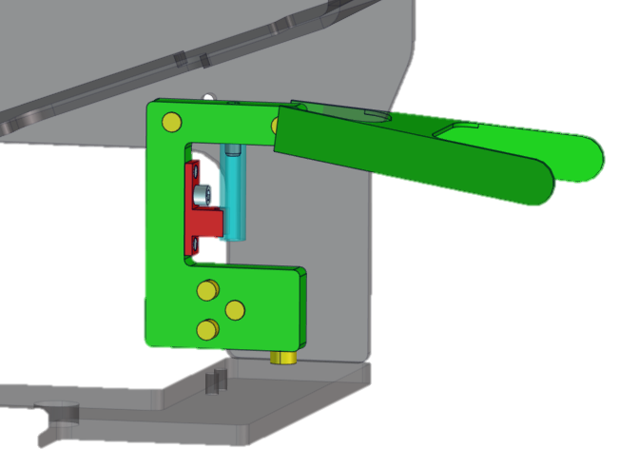
Tool Design
3 Pickoff tools

Slide 12
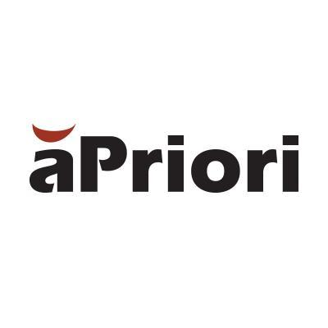
aPriori - Upgrade
Task:
Upgrade aPriori to latest version
Steps:
Run test parts in current version
Upgrade a test environment
Run test parts
Upgrade Production Environment
Run test parts
Release updated upgrade files and instructions

Slide 13
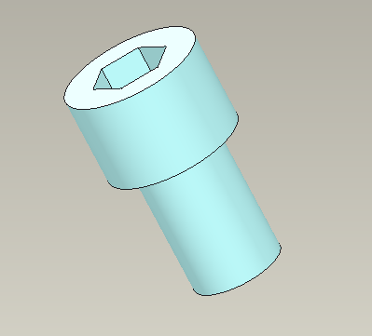
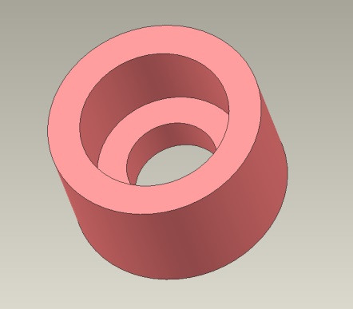
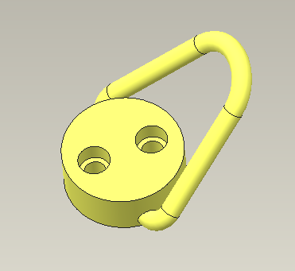
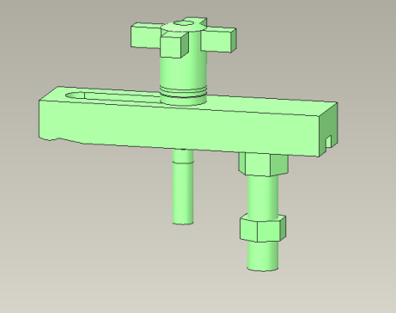
Standard Tooling Library – Update
Problem:
How to update/organize standard parts
Task:
Update the standard parts library
Steps:
Standard Library Cleanup
Different colors
Link to website
New Standard Parts
Master Assembly

Slide 14
Benefits
Me
Constraining Techniques
GD&T/Print Reading
CREO
Family tables
Hyperlinks
MySQL
Database Logic
DFM
HYG
Tools
Latest version of aPriori
Cost comparisons
Updated standard parts library

Slide 15
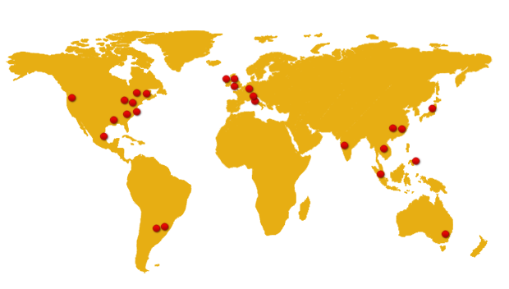
Department Interactions
Plants
Ramos (Mexico)
Craigavon (N. Ireland)
Greenville (N. Carolina)
Sulligent (Alabama)
Berea (Kentucky)
Pune (India)
CBDC
Engineering Operations
Hydraulic Systems Design
CoE Global Eng. Systems

Slide 16
Helpful Courses
WRI 227 – Tech Writing
ENGR 266 – Programming for Engineers
MET 241/242 – AutoCAD
MET 375 – CREO
MFG 314 – GD&T

Slide 17
Overall Impressions
Awesome People
Ready and eager to help
Collaboration
Projects
Large variety
Not extensively complicated
Lots of new technology
Great learning experience

Slide 18
QUESTIONS?

